Slide 1
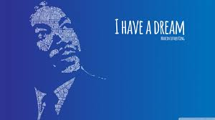
Warm Up
1) Main Idea!
Think back to the “I have a dream speech”…
What is the main point of this speech?
Notes:
I have a dream speech snippet (5 mins)

Slide 2
11-7 From Camelot to the Tall Texan
The 1960’s

Slide 3
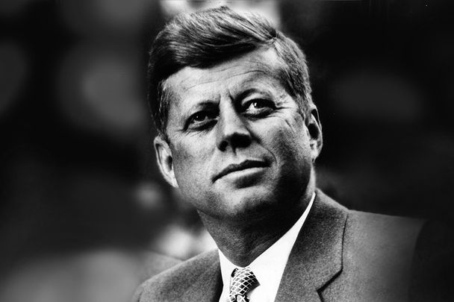
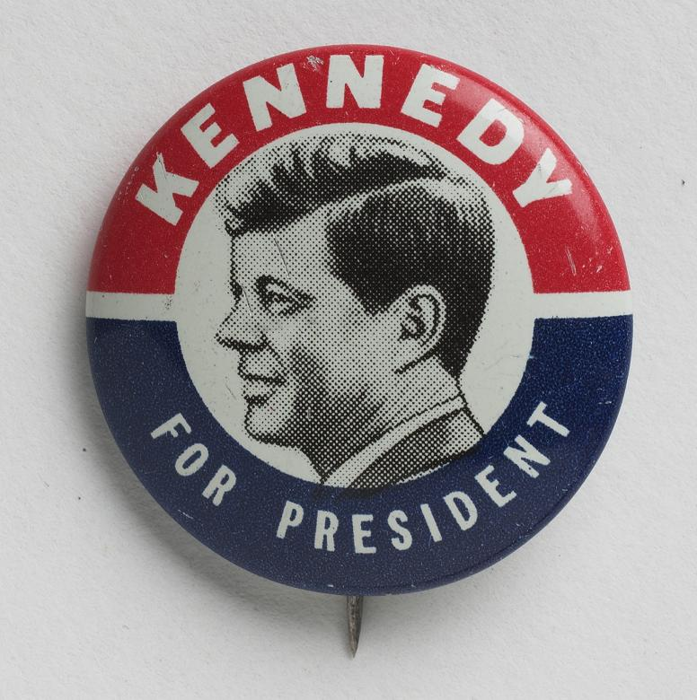
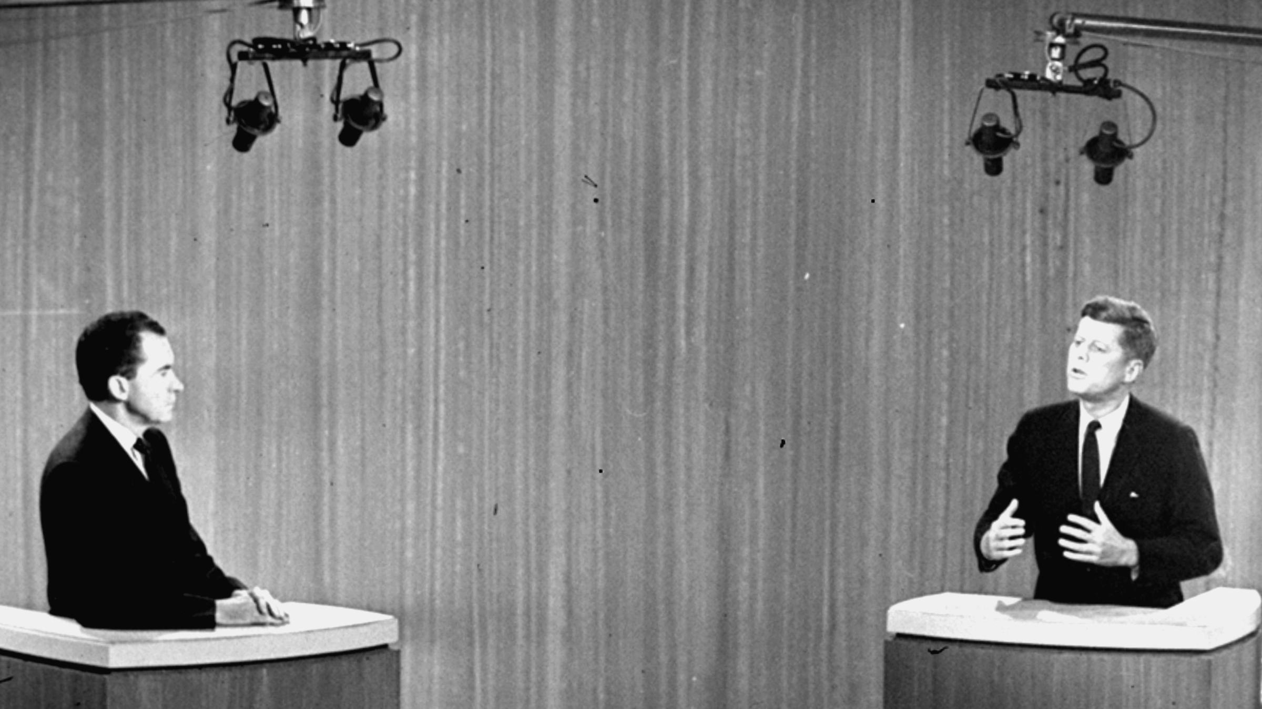
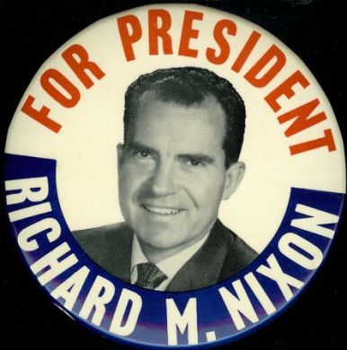
Election of 1960
2) Kenndedy Provided what?
John F. Kennedy v. Richard Nixon
Kennedy promised programs to help poor and elderly
Nixon promised to continue Eisenhower’s policies
JFK’s Profile
Wealthy and powerful political family
WW II Navy Veteran
Received military honors for saving a crew members life
Successful ran for House and Senate
Won Pulitzer Prize for his book Profiles in Courage
1960 Campaign
JFK behind most of the race because he was Roman Catholic
People not comfortable voting for a Catholic
Thought more allegiance to church versus nation
JFK emphasized separation of Church and State during his campaign
Turning Point came during…
First televised Presidential debates
People saw a youthful, handsome, energetic JFK
People saw a tired and sick looking Nixon
Many voted for JFK because of these debates
JFK won by less than 1% of the vote

Slide 4
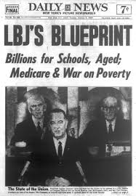
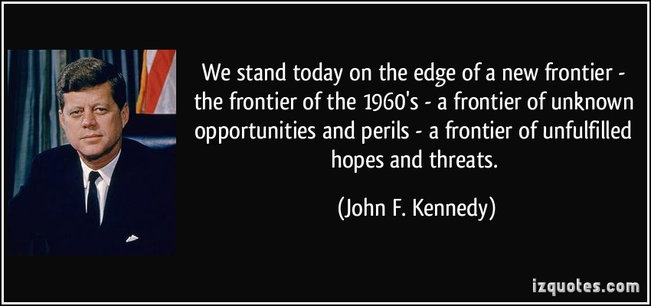
Domestic Programs
4) Foreshadow
The Great Society
3) LBJ’s Agenda?
The New Frontier
LBJ’s Domestic Agenda – WAR on Poverty
People should not live in poverty, go hungry, or be denied a good education
Head Start Program – preschool for low income families
Upward Bound – helped low income students attend college
Medicare – helped pay medical care for seniors
Medicaid – helped low income people pay their hospital bills
Food Stamps
Department of Housing & Urban Development (HUD) – funded public housing projects for low income people
Doubled amount of Federal money spent on education
Civil Rights Act of 1964
Completed work started by JFK
Prohibited discrimination against African Americans in
Employment
Voting
Public accommodations
Also banned any discrimination by
Race, color, sex, religion, or national origin
Voting Rights Act of 1965
aimed to overcome legal barriers at the state and local levels that prevented African Americans from exercising their right to vote
Ended literacy tests and investigated poll taxes
Provided federal oversee for voter registration where less than 50% on the non-white population had registered to vote
JFK’s Domestic Agenda
Increased Gov. spending on social programs
Additional money for education
Set up programs to help poor obtain jobs
Congress rejected – too expensive
May 1961 - Promised that the US would put a man on the moon by the end of the decade
Never finished his vision for the US

Slide 5
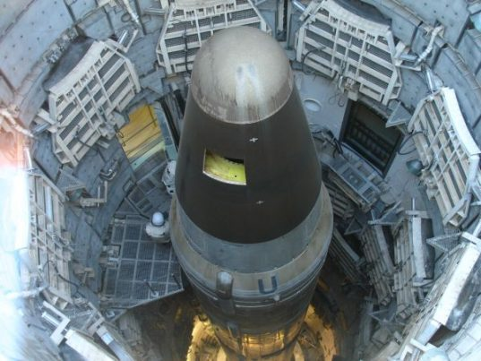
Cold War confrontations
JFK continued the anti-Communist policies of his predecessors
But with a few changes…
Increased spending on nuclear arms
Tried to convince USSR to agree to ban nuclear testing
Counter Soviet sponsored guerrilla warfare fighting around the world with American special forces trained in the same manner (Green Berets)
Believed in foreign aid to poor nations to try and make the promises of communism less attractive
Peace Corps
Americans volunteering to work as teachers, health workers, and agricultural advisors
Alliance for Progress
Development plan for Latin America

Slide 6
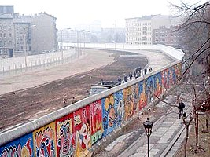
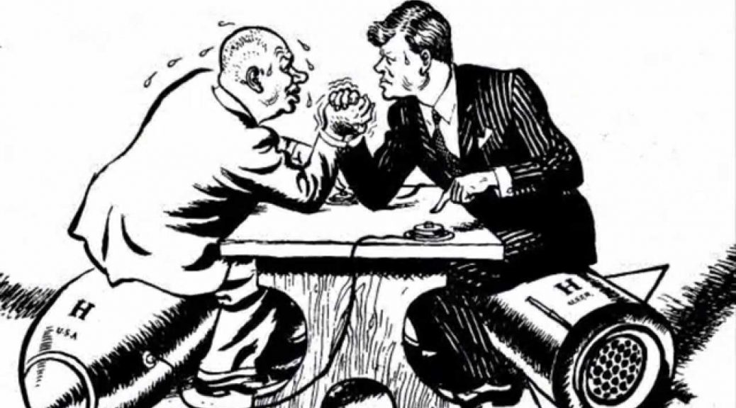
Cold War Confrontations
5) Relations with Cuba?
6) Cuban Missile Crisis?
Cuban Missile Crisis – 1962
US spy plan discovered that the Soviets were building nuclear missile launch sites on the island
JFK ordered blockade of Cuba
Promised to destroy any ship approaching the island
JFK also stated that any nuclear missile launched from Cuba would be considered a attack on the US by the Soviet Union.
It would be met with a nuclear attack on the Soviet Union
After a few tense days…
Soviet ships approaching Cuba turn back rather than try and break the blockade
Soviets also promised to withdrawal their missiles from Cuba
Results:
Closest the world has come to Nuclear War
Leads to a hot line to be established
Two nations also signed a treaty banning nuclear tests above ground and under water
Bay of Pigs - 1959
Fidel Castro seizes power & forms alliance with USSR
CIA planned to overthrow Castro
1,500 CIA trained Cuban exiles landed at the Bay of Pigs
JFK had doubts but went along with plan
Invasion was crushed by Castro
Consequences
JFK lost faith in military and intelligence advice
Latin America lost faith in JFK
Soviet leader Khrushchev thought JFK was weak and could be bullied
Berlin Wall
Summer 1961 after large # of East Germans fled to West Germany through West Berlin
East Germany with support of the Soviets erected the Berlin Wall
US and allies protested but could do nothing to stop it

Slide 7
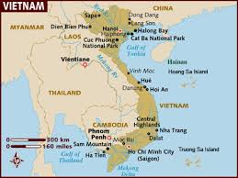
The U.S. and Vietnam
7) Advisors?
8) Visual Vocab
Eisenhower had sent billions of dollars, hundreds of troops, and military advisers
US supported South Vietnam because of the Domino Theory
JFK sent more military advisers and pressured the South Vietnam government to eliminate conditions that would spur Communism
Poverty, landlessness, lack of education, poor health care
Ngo Dinh Diem refused and opposition grew within South Vietnam
Aid from the Communist North Vietnam flowed in to fuel the guerrilla war against Diem
National Liberation Front or Vietcong
1963 – South Vietnamese military overthrew Diem and assassinated him
JFK supported coup but not assassination

Slide 8
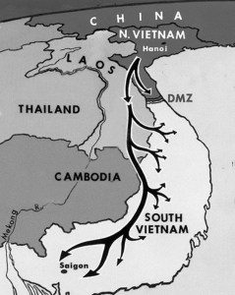
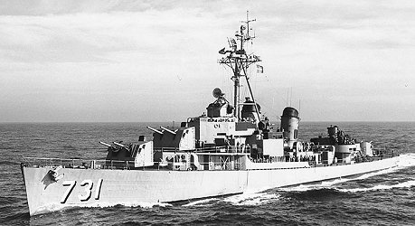
The Conflict Deepens
9) POTUS can do what?
Difficulties for US Soldiers
Dense jungles, muddy trails, and swamps made troop movement difficult
Vietcong guerrillas (NLF) blended in with the rest of Vietnamese population
Hard to tell friends and enemies apart
American allies in the army of South Vietnam often did not fight effectively
Lethal Weapons
Aside from conventional bombs
Dropped napalm
Explosive that burned intensely (800 -1200 degrees)
Toxic herbicide called Agent Orange (banned in 1971 by US)
Used to destroy vegetation that enemy used for cover
Contaminated many American and Vietnamese
Causing severe health problems
After JFK’s death the problem of Vietnam fell to LBJ
LBJ wanted Congressional support
Gulf of Tonkin Resolution – 1964
North Vietnamese naval forces allegedly attacked US destroyers in the Gulf of Tonkin (USS Maddox)
Allowed President to take “all necessary measures” to repel an armed attack against US forces
LBJ used this to slowly escalate US involvement in Vietnam
By 1968 – roughly 500,000 soldiers in Vietnam
Began intense bombing of the Ho Chi Minh Trail and other military targets
North Vietnamese used trail to bring weapons and supplies into South Vietnam

Slide 9
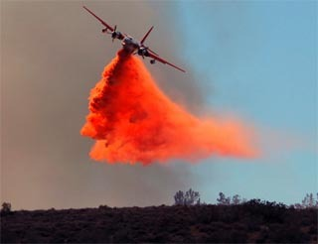
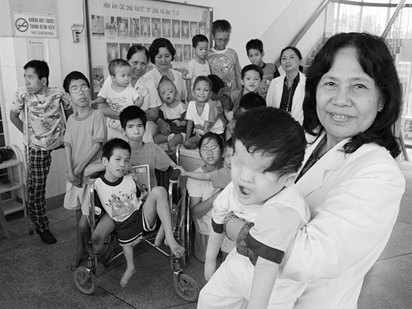
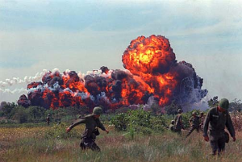
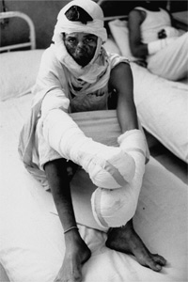
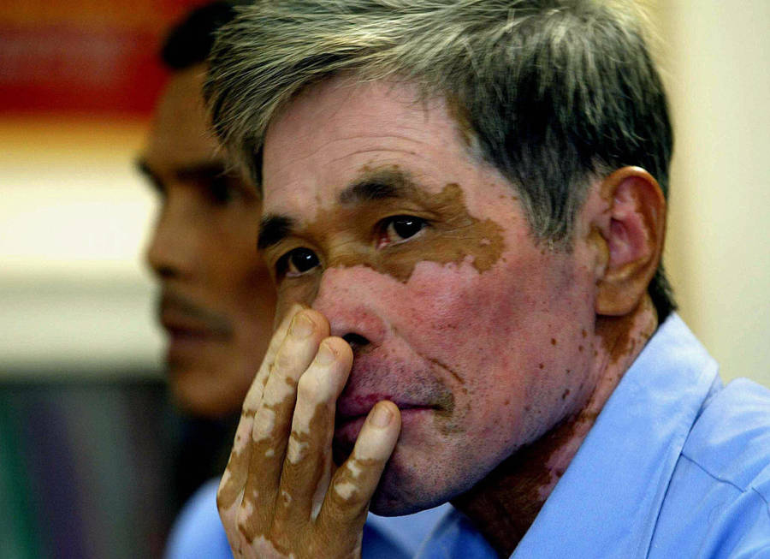
Short-term exposure to agent orange can cause darkening of the skin, liver problems and a severe acne-like skin disease.
Long term exposure results in many cancers such as Hodgkin disease, Non-Hodgkin lymphoma, Prostate cancer, Cancer of the lung, bronchus, larynx (voice box), or trachea (windpipe), and soft tissue sarcoma.
The chemical is capable of damaging genes, resulting in deformities among the offspring of exposed victims.

Slide 10
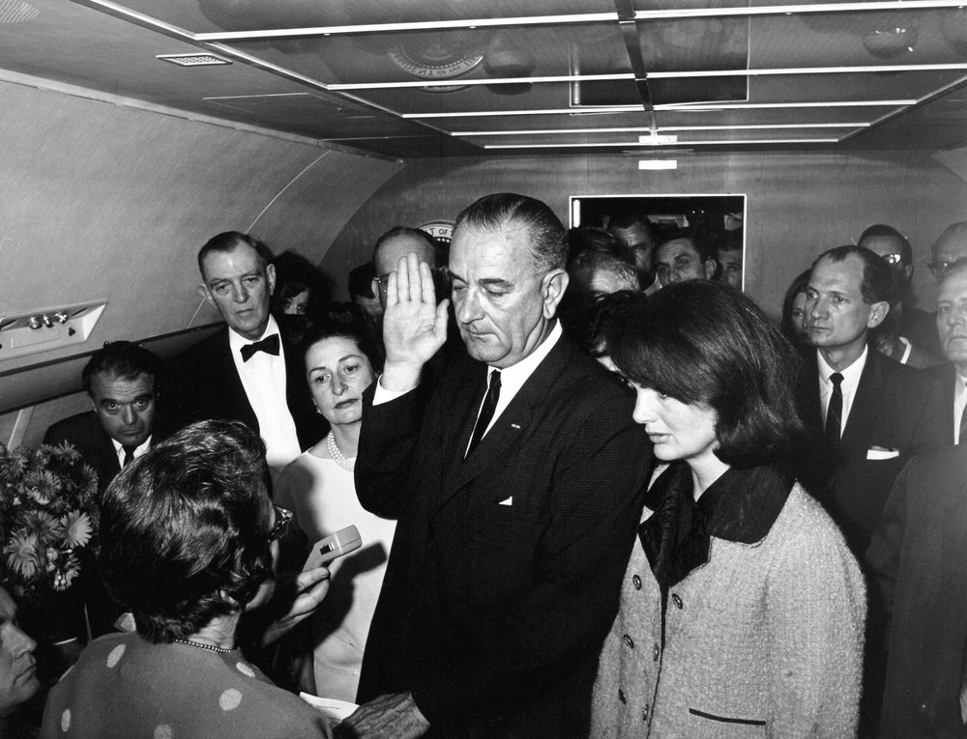
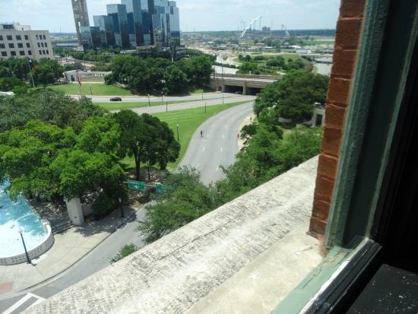
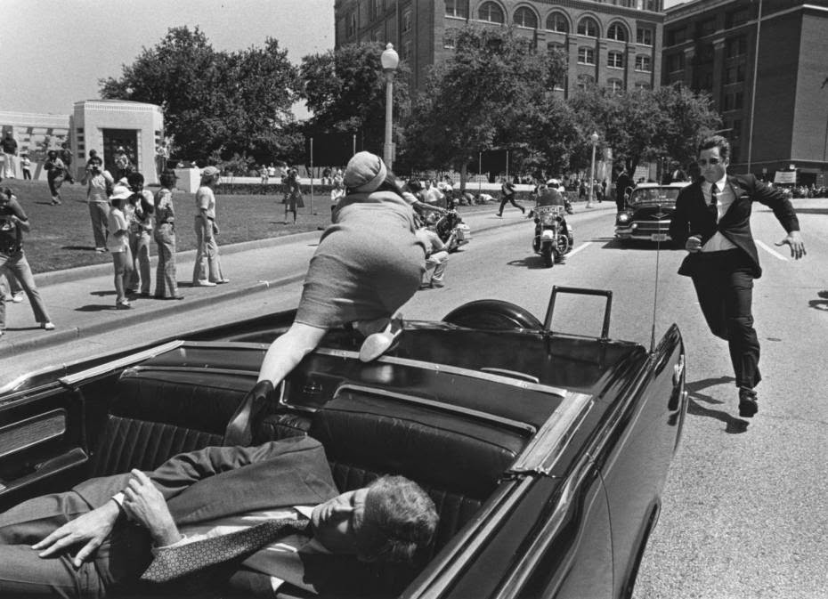
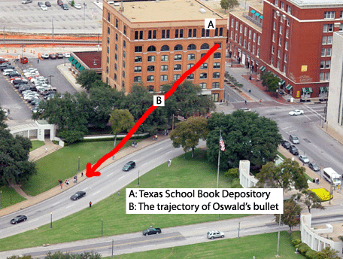
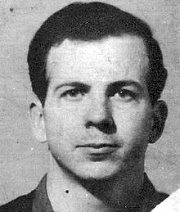
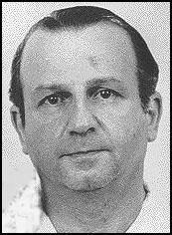
The Conflict Deepens
As it was passing the Texas School Book Depository…
gunfire suddenly reverberated in the plaza.
Bullets struck the president's neck and head and he slumped over toward Mrs. Kennedy.
The governor was also hit in the chest.
The president's body was brought to Love Field and placed on Air Force One.
Before the plane took off, a grim-faced Lyndon B. Johnson stood in the tight, crowded compartment and took the oath of office.
Less than an hour earlier, police had arrested Lee Harvey Oswald, a recently hired employee at the Texas School Book Depository.
He was being held for the assassination of President Kennedy and the fatal shooting, shortly afterward, of Patrolman J. D. Tippit on a Dallas street.
On Sunday morning, November 24th…
Oswald was scheduled to be transferred from police headquarters to the county jail.
Viewers across America watching the live television coverage suddenly saw a man aim a pistol and fire at point blank range.
The assailant was identified as Jack Ruby, a local nightclub owner.
Oswald died two hours later at Parkland Hospital.
10) JFK
American war tactics caused enormous Vietcong losses but…
People with in LBJ’s Administration believed
that the ground battles and air attacks still could not win the war.
Also…
American public opposition to the war began to grow
November 22, 1963
Kennedy traveled to Dallas for a campaign trip
Crowds of excited people lined the streets and waved to the Kennedys.
The car turned off Main Street at Dealey Plaza around 12:30 p.m.

Slide 11
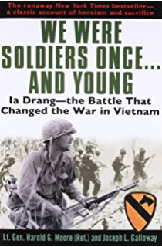
Exit Ticket
What was the “main idea” of the reasoning behind the Vietnam War?
11) Exit

