Slide 1
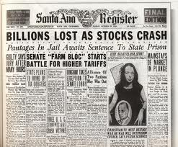
10-3 The Great Depression
From Boom to Bust

Slide 2
Warm Up
1) Warm Up
“MARKET CRASHES—PANIC HITS NATION!” one headline blared. . . . I couldn’t imagine such financial disaster touching my small world; it surely concerned only the rich. But by the first week of November I too knew differently; along with millions of others across the nation, I was with out a job. All that next week I searched for any kind of work that would prevent my leaving school. Again it was, “We’re firing, not hiring.”. . . Finally, on the seventh of November I went to school and cleaned out my locker, knowing it was impossible to stay on. A piercing chill was in the air as I walked back to the rooming house. The hawk had come. I could already feel his wings shadowing me.
—Gordon Parks
1) Why do you think Gordon Parks believed that the Stock Market Crash would have no effect on his “small world”?

Slide 3
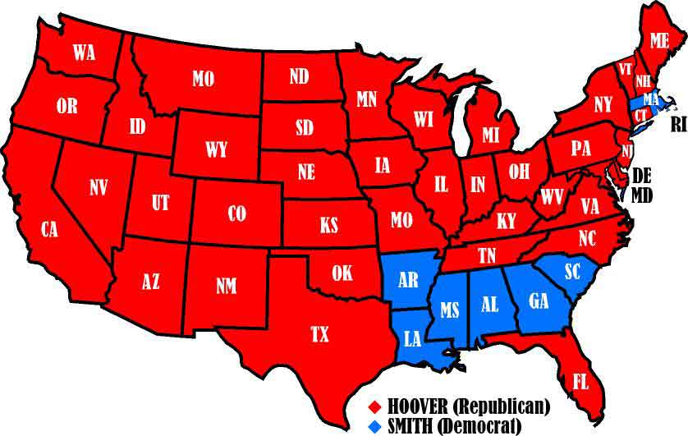
A Rosy Outlook
2)Describe the economy
In the 20’s economy boomed…
Can only get better when Sec. of Commerce Herbert Hoover is elected to Pres in 1928!
On surface many had good reason 4 optimism
Industry booming
Became more efficient
Produced more products
Ford’s Assembly Line
Advertising methods convinced the people they needed these products
Bought they did…
In record numbers
Mostly on credit

Slide 4
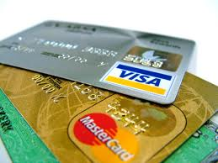
Weaknesses in the Economy
3) How can credit change your life?
Yet there were problems
The booms hid some serious problems w/ industry
By 1929, 71% of Americans earned less than $2,500 / year
Some could buy new products, but…
Most fams only buy on credit
Manufacturers made sure getting credit was easy
Credit companies kept rates low so more people would buy on credit to get their goods
Problem was they were getting deeper and deeper in debt

Slide 5
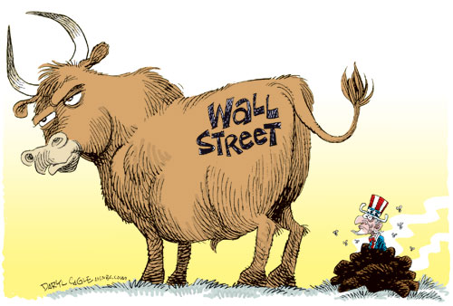
The Great Bull Market
4) Define Bull Market & Buying on Margin
As businesses boomed, people wanted to share in their profits
Buying stock in a company
Since many couldn’t afford it…
Bought on credit, called “buying on margin”
If stock rose… people could sell their shares to pay off what they owe and keep the difference
If stock fell… they were responsible for the original cost + the difference
Buyers also purchased in a Bull Market, where prices rose and rose and seemed to never go down
Want to get in when prices low and sell b4 the price drops
In 1920’s- nearly one ¼ of the population gambled in stock market
1929- prices finally met their limits
The bottom dropped quickly
People stopped buying, manufacturers produced less, lost money, laid off workers, companies couldn’t pay debts
Creditors tried to claim their debts to keep afloat but people hadn’t the money

Slide 6
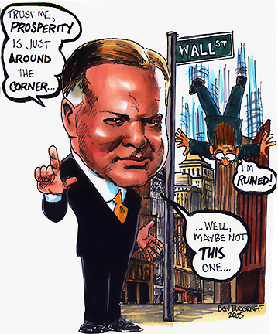
The Crash of ‘29
5) Define Margin Calls
Goods piled up unsold
Profits sank
Stocks plummeted!
Starting in Sept. 1929
In desperate attempt to save the “ship,” stockbrokers sent out margin calls
debts from people buying on margin
People sold all stocks to pay debts
More people tried to sell than buy and the market tanked!
24 Oct. 1929- Black Thursday
Companies tried to buy up stocks to halt the panic… it didn’t work!
29 Oct. 1929- Black Tuesday
The entire market crashes!!!
The banks, and public lost everything
6) What was Black Tuesday?
7) Video Facts
Notes:
1929: Black Friday: A stock-market crash and its consequences(8:35)

Slide 7
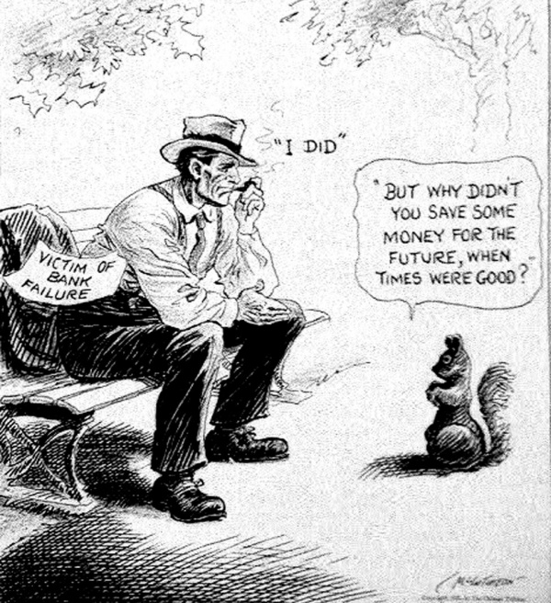
The Great Depression
8) What protects peoples $ now?
When people deposit $$$ in banks, banks invest that $$$ to make more
When the market crashed…
People tried to withdraw their $$$ from the banks to pay debts, the banks didn’t have it anymore!!!
Banks closed and panic set in!!!
By 1933- 9,000+ banks had collapsed, taking many people’s life savings w/ them
People couldn’t buy anything
Product piled up and companies went bankrupt
Left people w/o jobs
25% of population was out of work
Banks, recalled loans in order to pay their debts
People couldn’t pay, so banks took homes and land leaving many homeless
Millions went hungry
US had gone through depressions b4, but nothing like this!!!
Becomes known as The Great Depression
Notes:
Great Depression (4:09)

Slide 8
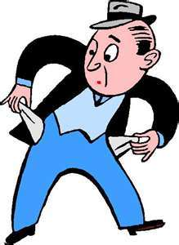
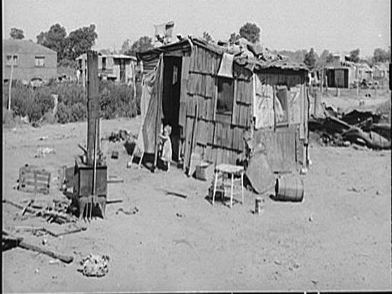
Herbert Hoover Responds
9) Who did people blame and what was named after him?
Hoover wanted the gov’t to help
Can’t just give cash… people get lazy
Gets industry leaders to help
Promise not to drop wages
RR and utility companies invest 2 billion in construction and repair projects
Provide jobs
Congress cut taxes and increased public works projects (public resources like roads, dams, bridges, etc)
Despite efforts depression got worse
Congress raised taxes on imports for $$$, only ended up raising cost of products
Hoover still refuses direct hand-outs
People begin to blame Hoover for their suffering
Called empty pockets turned out “Hoover Flags”
Called shacks built by homeless “Hovvervilles”

Slide 9
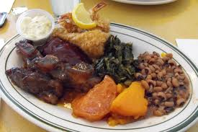
The Depression in NC
10) Why did people still buy liquor if they had no money?
Like rest of country, NC suffered
194 banks closed
Many lost their homes, businesses, and farms as a result
Many moved into mill towns and cities to look 4 work
State’s furniture and textile businesses crumbled
No one could afford to buy these luxury items
Production and profits cut in half
Wages slashed
Liquor and tobacco companies weren’t hit as hard
Why?
People survived on whatever could gather and made best out of it, start of…
Soul Food
Etc.
Notes:
Food Lines and Depression Food (1:59)

Slide 10
Exit Ticket
Homework: The Crash of 1929
What spurred the crash of 1929? What was the result of the crash?

